Slide 1
Azure Virtual Data Centre Architecture
Richard Cheney
Cloud Solution Architect

Slide 2
Before we start, kick off the lab build process! Aka.ms/citadel/vdc

Slide 3
What is a VDC and why do we need it?

Slide 4
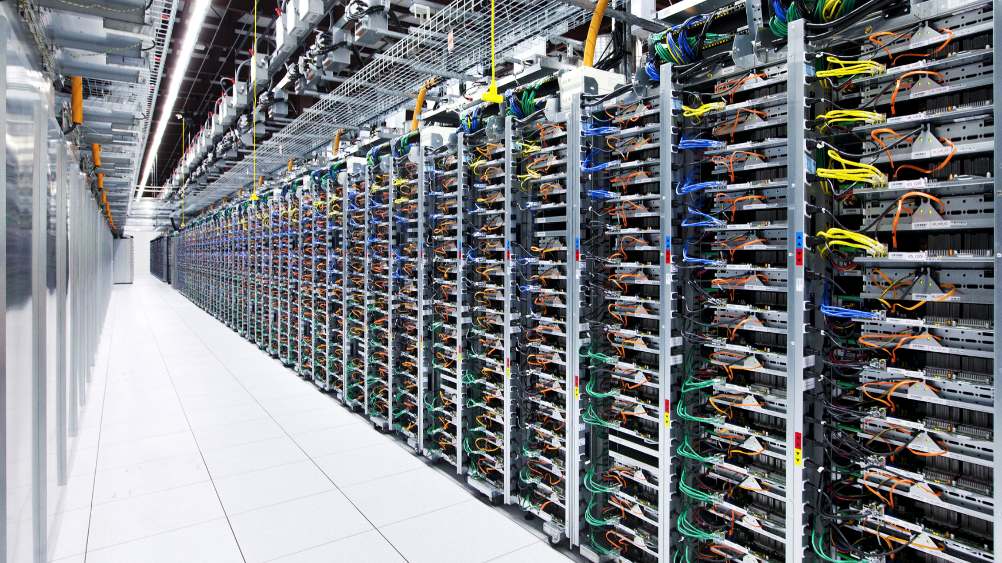

Slide 5
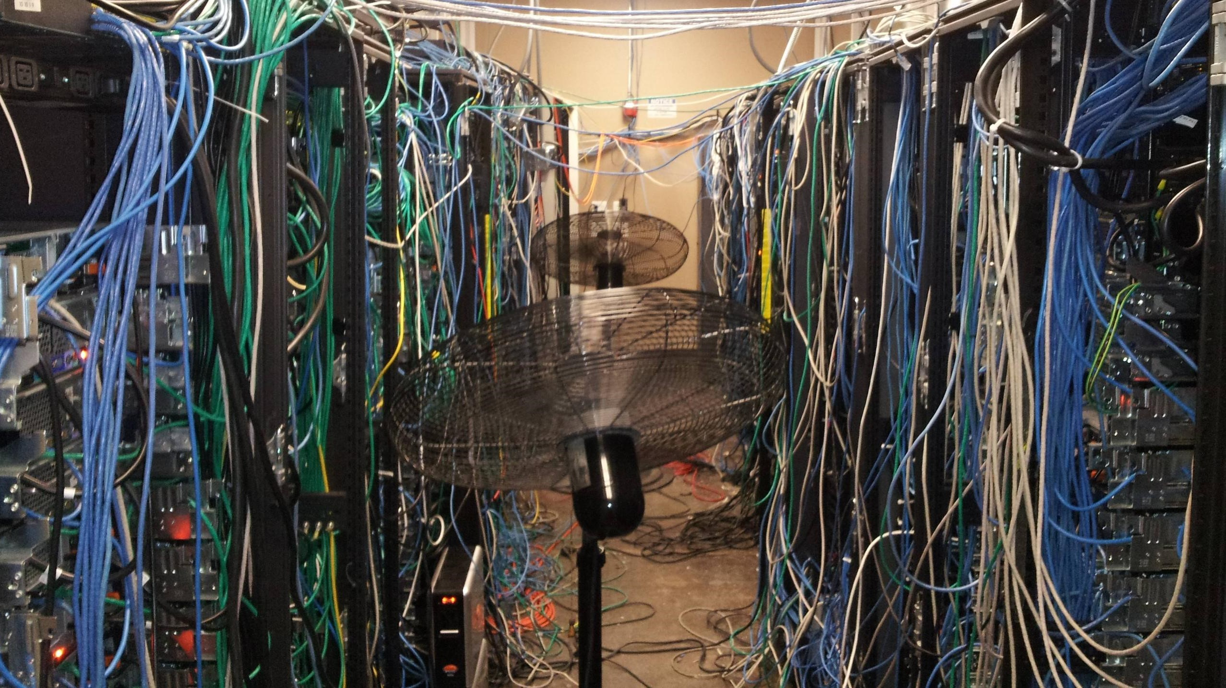

Slide 6
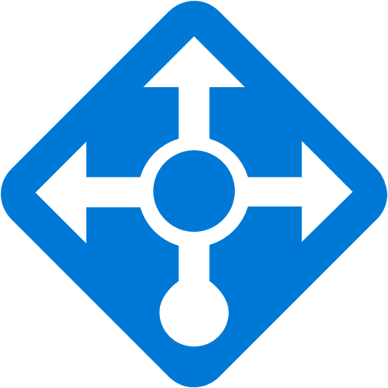
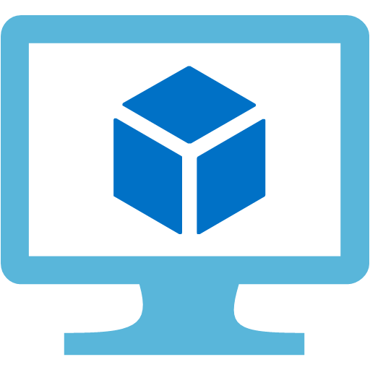
Outside World
Service 1
Service 2
Service 3

Slide 7
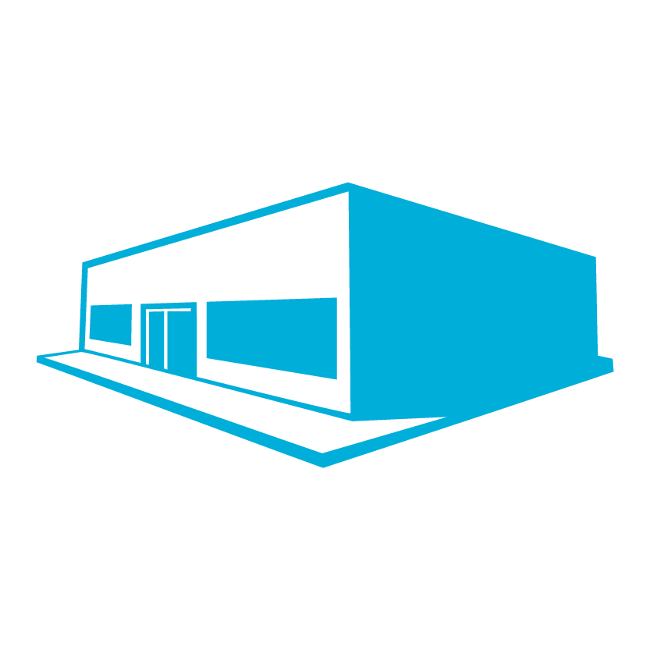
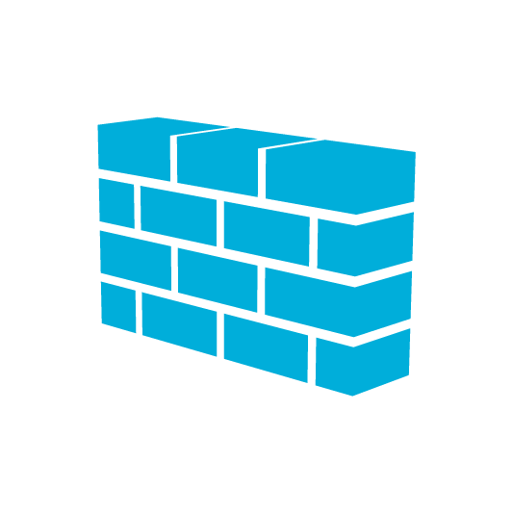
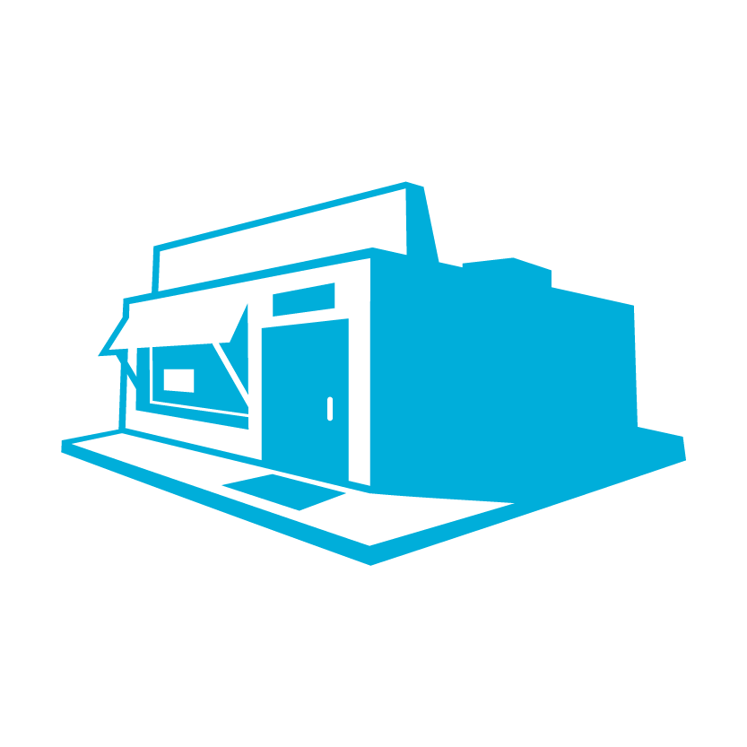
Internet
Remote Offices
Internet Edge
WAN Edge
3rd Party Connections
DMZ
Hub / Shared Services
Management / Monitoring Network

Slide 8

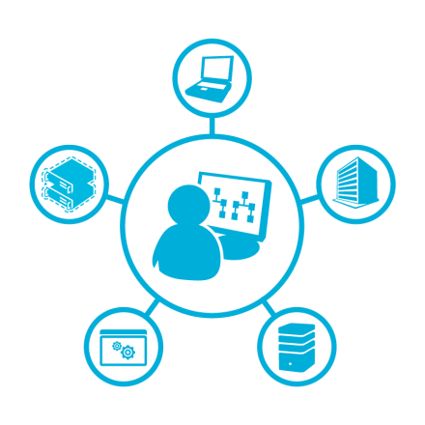
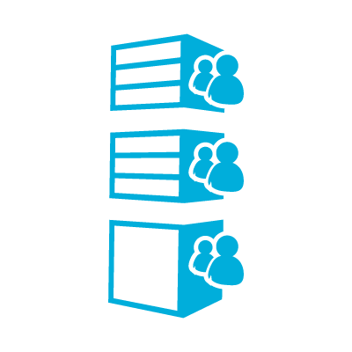

Customers want the same levels of isolation, security policy, monitoring and identity that they have in their DCs today.

Slide 9

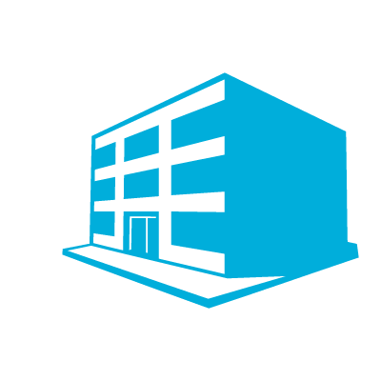
Azure VDCs bring together networking, security, management and identity to meet these requirements.
Perimeter: Internet
Perimeter: On-Premises
Shared Workloads
Infrastructure
Monitoring
Workloads
Workloads
Workloads
Infra
Infra
Infra

Slide 10
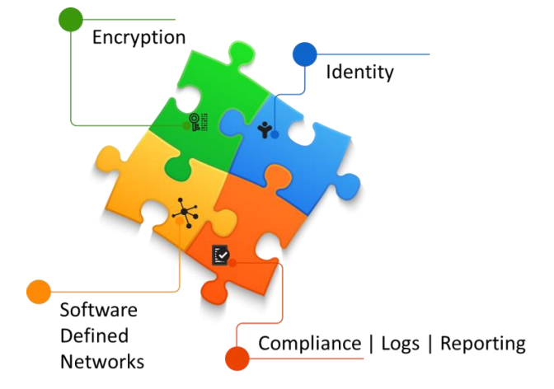
Notes:
Software Defined Networking allows you to build whatever topologies you like in a flexible way, incorporating firewalls, load balancers, intrusion prevention and routing policy.
Encryption allows you to isolate confidential info from the rest of the infrastructure, whether that data is at rest or in transit.
Identity is the thing that governs access to all of your resources in a virtual DC, including compute, networking, data and applications
Compliance in a virtual DC means taking advantage of monitoring, logging and reporting to ensure your systems are functioning as they should be and complying with the policies that you have.

Slide 11
Migrating on-premises workloads into Azure
How can VDCs help?
Microsoft Azure

Slide 12
Implementing centralised security and access policies for workloads
How can VDCs help?
Centralised Infrastructure
Infra policy
Workloads
Workloads
Workloads
App policy
App policy
App policy

Slide 13
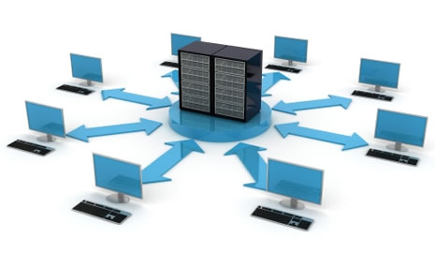
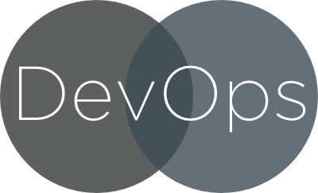
Mix DevOps and centralised IT
How can VDCs help?
+

Slide 14
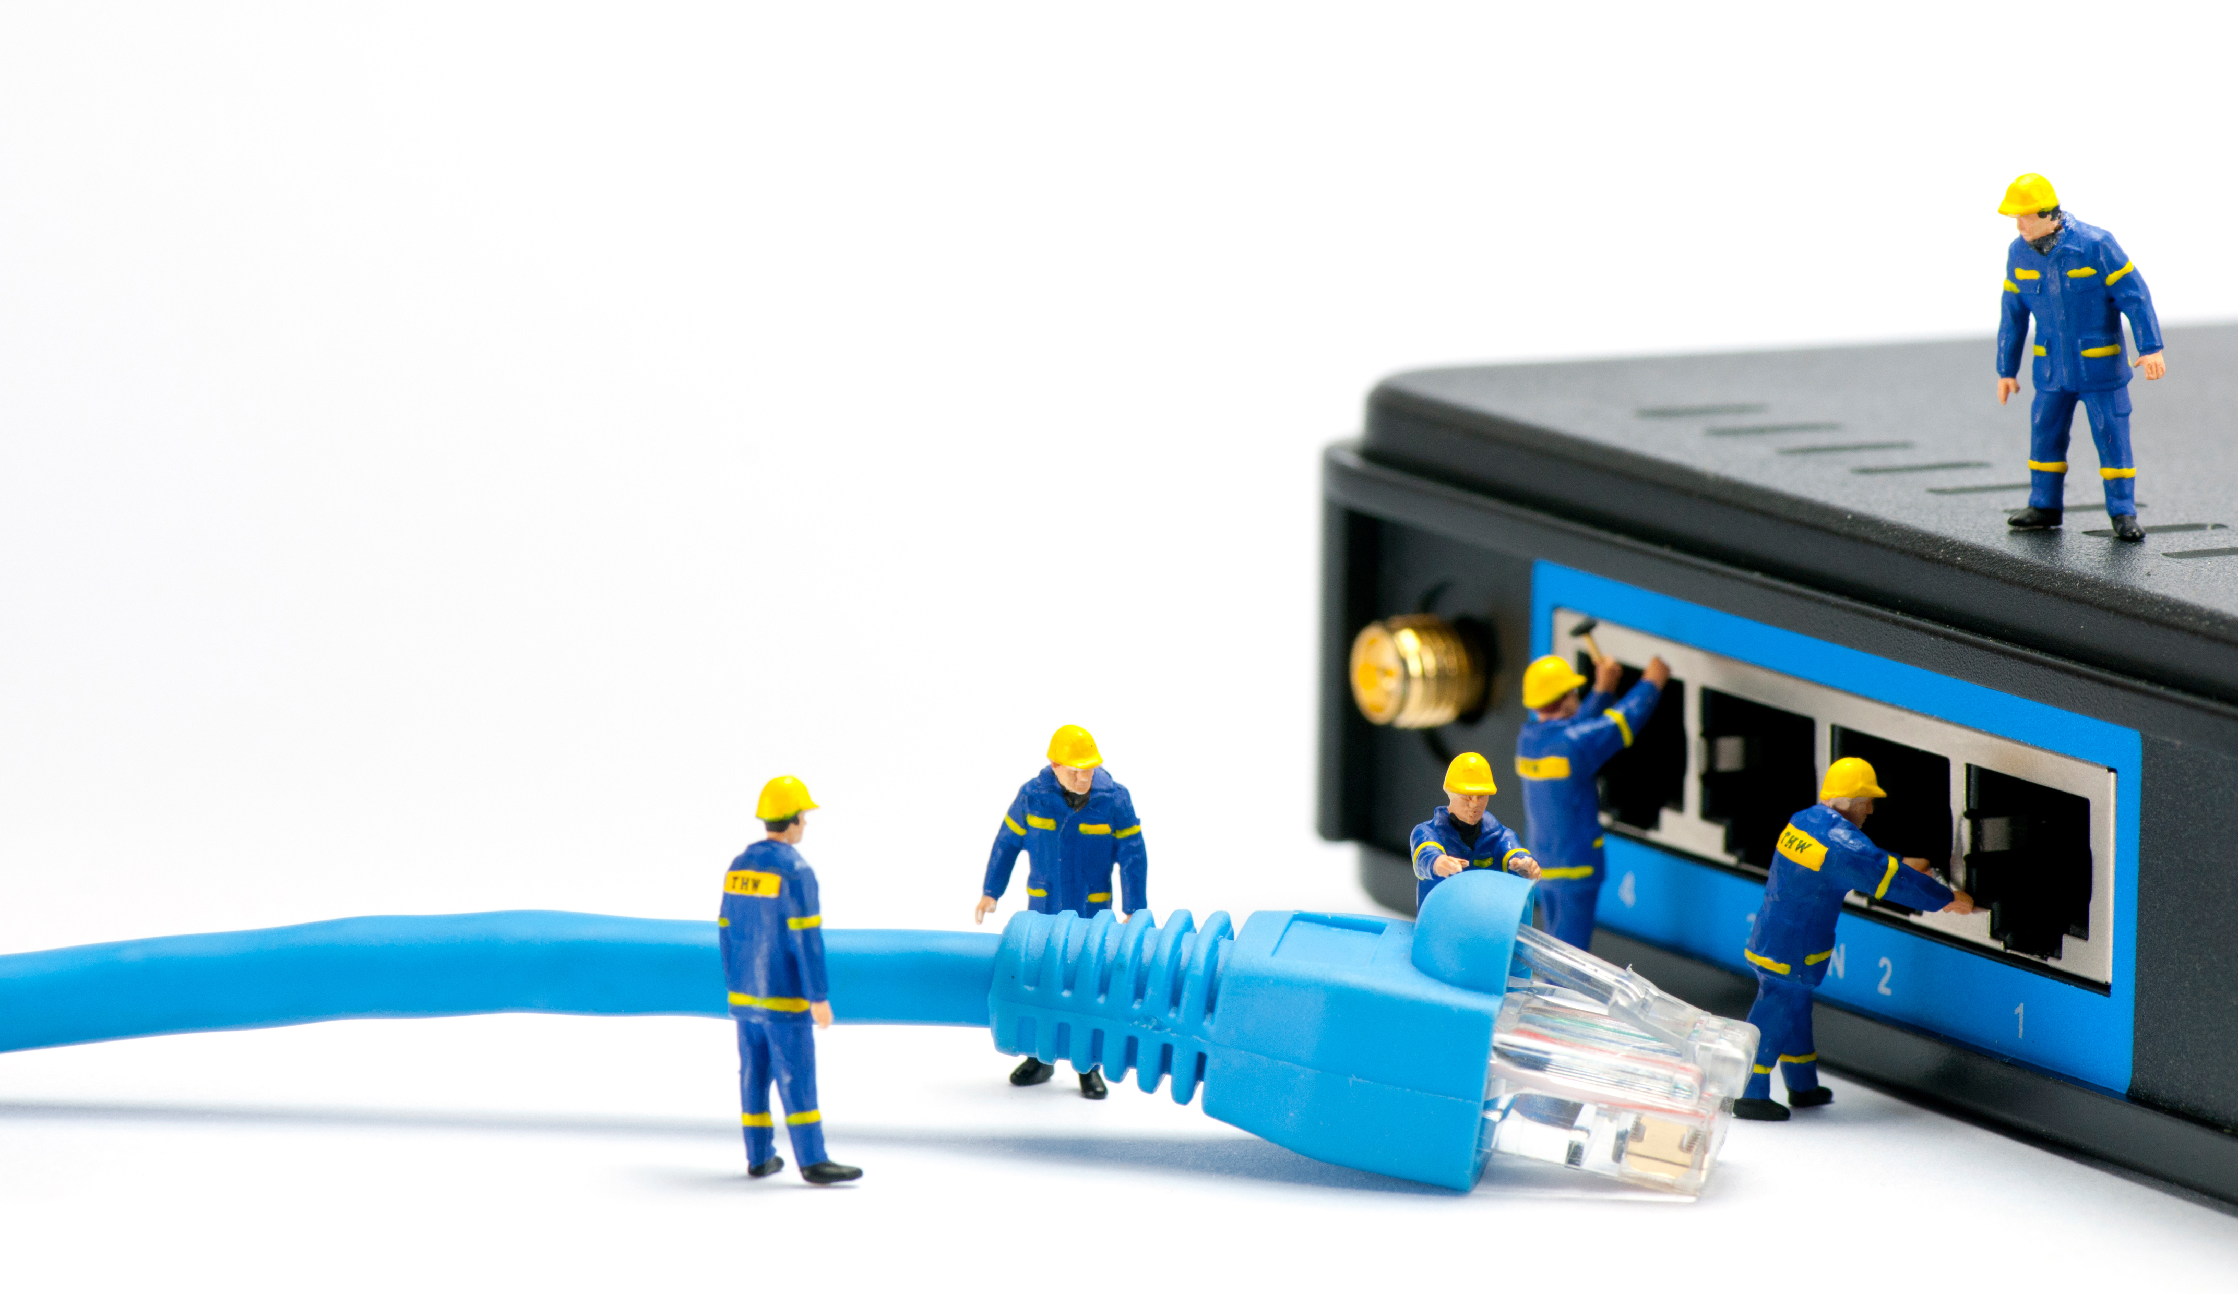
VDC Network Infrastructure

Slide 15
Network Infrastructure

Slide 16
Network Infrastructure
Hub & Spoke networking enables central policy enforcement.

Slide 17
Network Infrastructure
The hub may contain central services such as AD infrastructure, DNS, PKI and more.

Slide 18
Network Infrastructure
User Defined Routes for greater control over routing
User Defined Routes for greater control over routing

Slide 19
Network Infrastructure
Network Security Groups and / or 3rd party appliances for security enforcement

Slide 20
Network Infrastructure
ExpressRoute for private connectivity between Azure VDC and on-premises

Slide 21

Identity and Security in the VDC Environment

Slide 22
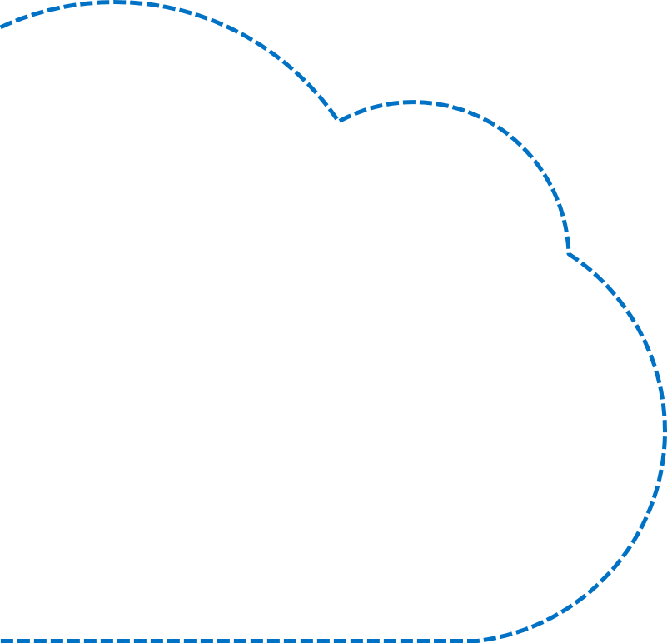

Trust through isolation
Assign roles to users and groups at subscription, resource group, or resource level.
Use built-in roles with
pre-configured permissions.
Reader
Owner
Contributor
Reader
Owner
Contributor
Notes:
For example, you have a Network Operator role within your organization – that person is responsible for overseeing the operation of the virtual networks, or even just a single VNet. However that person has nothing to do with the operation of virtual machines, applications or other services within your environment. So you want to ensure that anyone with the Network Ops role has access to the networking aspects of the infrastructure, but no access to anywhere else.

Slide 23
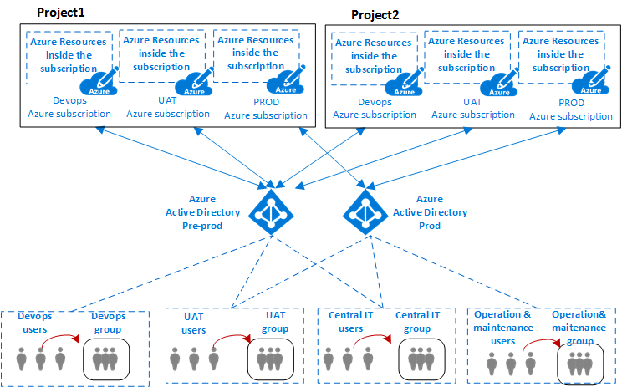
A VDC can be partitioned to securely host multiple projects.
This can be achieved using either subscriptions or resource groups.
Notes:
For example, you have a Network Operator role within your organization – that person is responsible for overseeing the operation of the virtual networks, or even just a single VNet. However that person has nothing to do with the operation of virtual machines, applications or other services within your environment. So you want to ensure that anyone with the Network Ops role has access to the networking aspects of the infrastructure, but no access to anywhere else.

Slide 24
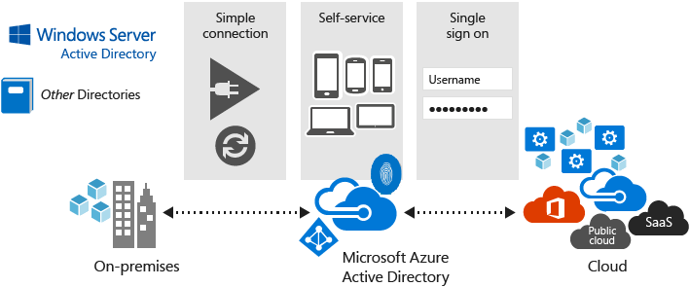
Azure AD: a multi-tenant, cloud based directory service.
Notes:
Azure AD is essential for managing access to a virtual DC environment.
Azure AD roles are used to provide Role Based Access Control, used for controlling access to resources such as VMs, storage, databases and network
Multi-Factor authentication is an essential part of the identity puzzle and should be used in almost every case.

Slide 25
Common roles vs application specific roles
Common IT Infra Groups | Workspace Specific Groups
CorpSecOps | AppSecOps
CorpNetOps | AppNetOps
CorpSysOps | AppSysOps
CorpDevOps | AppDevOps
Notes:
You can be more granular with roles – for example, a set of roles that pertain to the common environment and a different set of roles that relate to the specific applications.

Slide 26
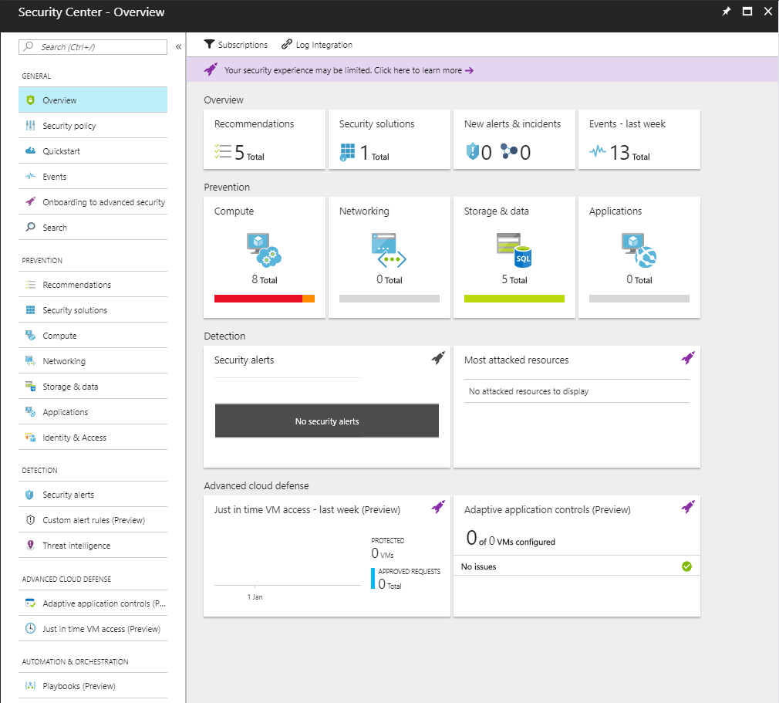
Azure Security Center
Notes:
Show Azure Security Centre

Slide 27



Azure Policy How do I stay compliant in my environment?
A
B
Dv3
Ev3
F
G
NC
M
Notes:
Azure Policy is used to control what people can do, for example – I want to limit users to certain virtual machine sizes only, or I want to ensure users create resources within Azure ONLY when they apply a tag.

Slide 28

Monitoring

Slide 29

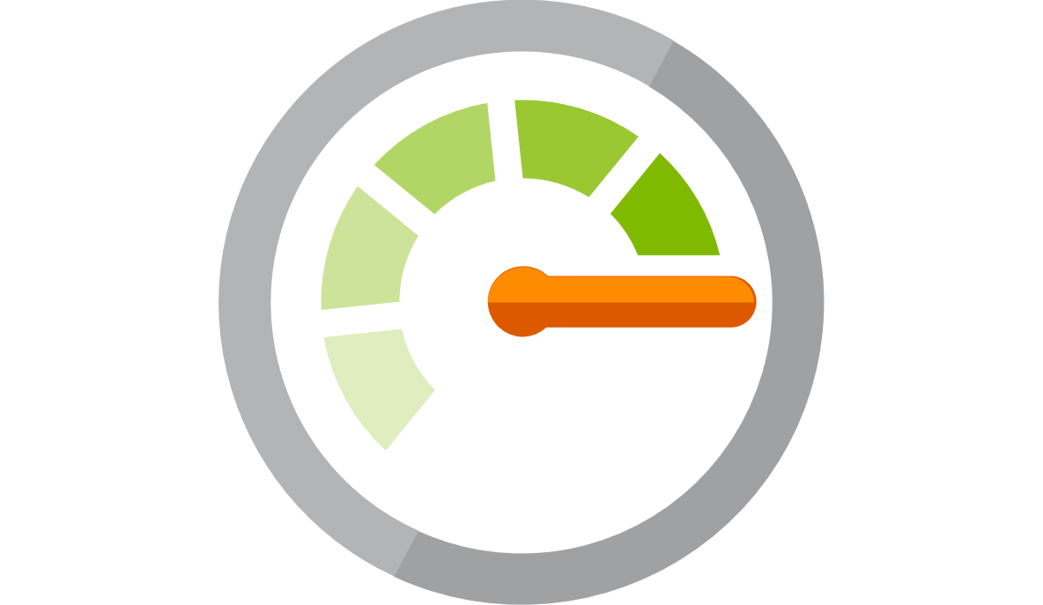
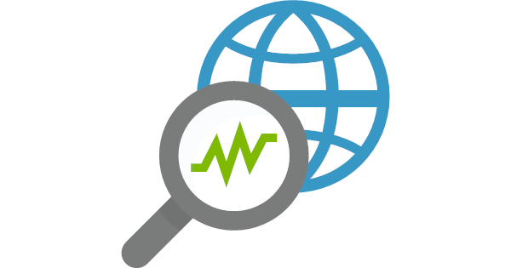

Monitoring is key in a VDC environment – Azure offers many logging and monitoring services.
Service Health
Azure Monitor
Network Watcher
Operations Management Suite

Slide 30
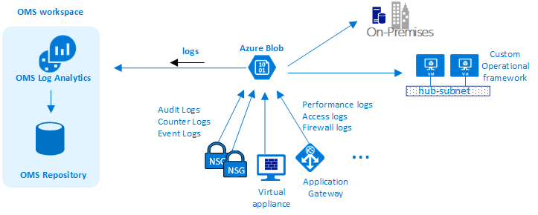
Logs can be sent to Azure storage or to OMS (log analytics).
Notes:
Most services in Azure can generate diagnostic logs – these can provide very rich data about what that resource is doing. The question is, what do we do with all that data?
Log analytics can help to collect, correlate, search and also act on that data that gets generated by your services.

Slide 31

What’s covered in the lab?

Slide 32
You’ll be building a full VDC environment, covering networking, security, monitoring and identity.

Slide 33
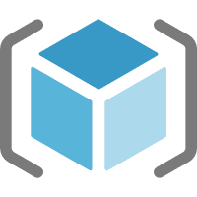


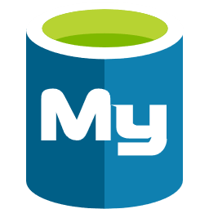
Resources deployed into multiple resource groups.
VDC-Hub
VDC-NVA
VDC-Spoke1
VDC-OnPrem
VDC-Spoke2

Slide 34
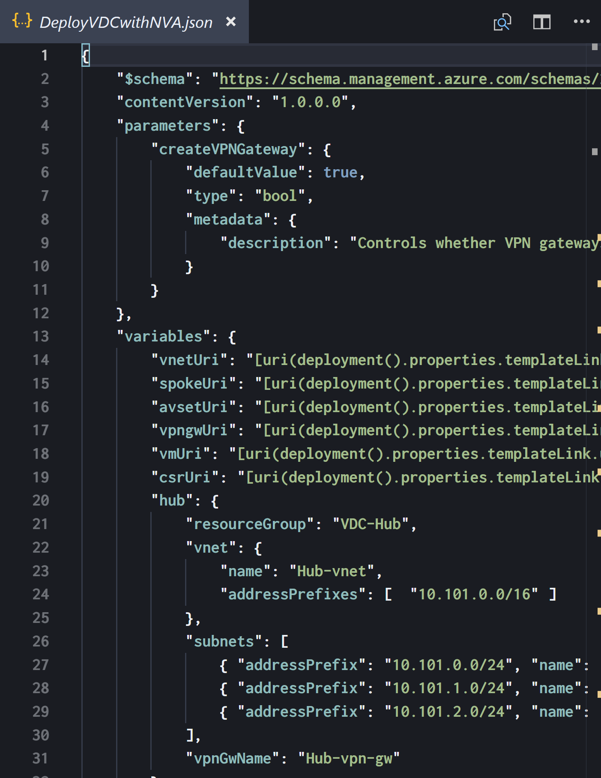
ARM templates are used to build out the initial ‘base’ environment.

Slide 35
A ‘master’ ARM template runs which in turn calls a number of other templates.
DeployVDCwithNVA.json
nested/vnet.json
nested/spoke.json
nested/avset.json
nested/vm.json
nested/vpngw.json
nested/ciscoCSR.json

Slide 36
Part 1: Explore the Lab

Slide 37
Part 2: Networking
Site-to-Site VPN
Cisco CSR1000V Configuration
User Defined Routes

Slide 38
Part 3: Security
Network Security Groups
Azure Security Center
Azure Resource Policies

Slide 39
Part 4: Monitoring
Network Watcher
NSG Flow Logs
Metrics, Alerts & Diagnostics with Azure Monitor

Slide 40
Part 5: Identity
Users and Groups
Role Based Access Control

